Slide 1
BeatBuddy
Y suresh babu - AP21110011289
MD abdulla- AP21110011283
M vamsi sasidhar - AP21110011287

Slide 2
Table of content
Introduction
Functionality
Diagrams
Working model
conclusion

Slide 3
Introduction
Song Recognition:
Quickly identify songs using advanced audio recognition technology. Record a portion of the song or input its title for instant identification.
Built-In Downloader:
Download songs in various formats and quality levels for offline playback.Offers a seamless and efficient download experience.
Music Player:
Essential controls: play, pause, skip, repeat, and shuffle. Effortlessly interact with your personalized music experiences.

Slide 4
Song Recognition:
Identify songs quickly by recording a short audio clip
Uses advanced audio recognition technology for high accuracy across different song genres.
Provides comprehensive metadata, including artist, album, genre, and release date.
Provides the option to download the respective song if need be

Slide 5
Built-In Downloader:
Download songs directly within the application without needing external tools or services.
Provides an efficient download process that prioritizes speed and reliability.
Allows offline playback of downloaded songs, enabling users to enjoy their music without an internet connection.
Automatically organizes downloaded songs into user-defined categories or playlists for easy management.

Slide 6
Music Player :
Provides essential playback controls such as play, pause, skip, repeat .
Supports a variety of audio file formats, offering flexibility in music playback.
Features a sleek, user-friendly interface that enhances the overall listening experience.
Enables smooth navigation and browsing through the music library for easy access to songs.

Slide 7
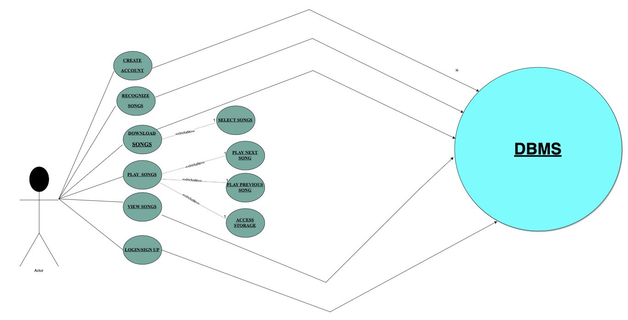
Designing phase :
Use - case diagram :

Slide 8
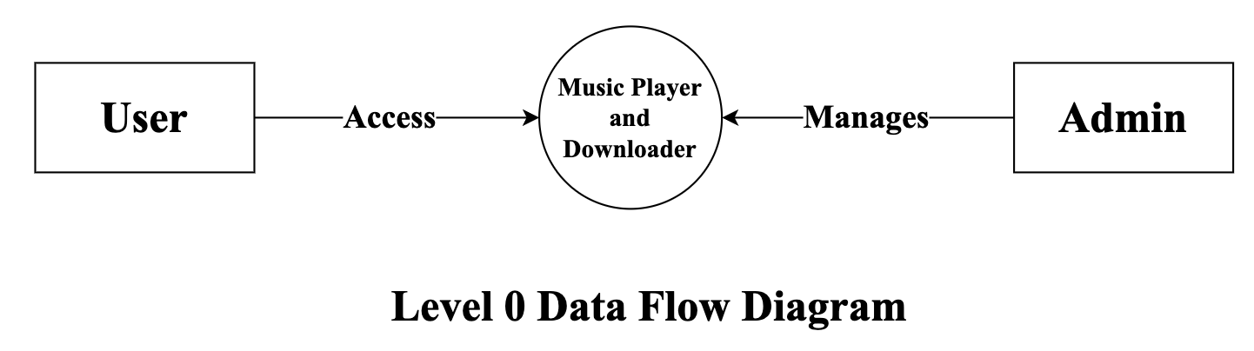
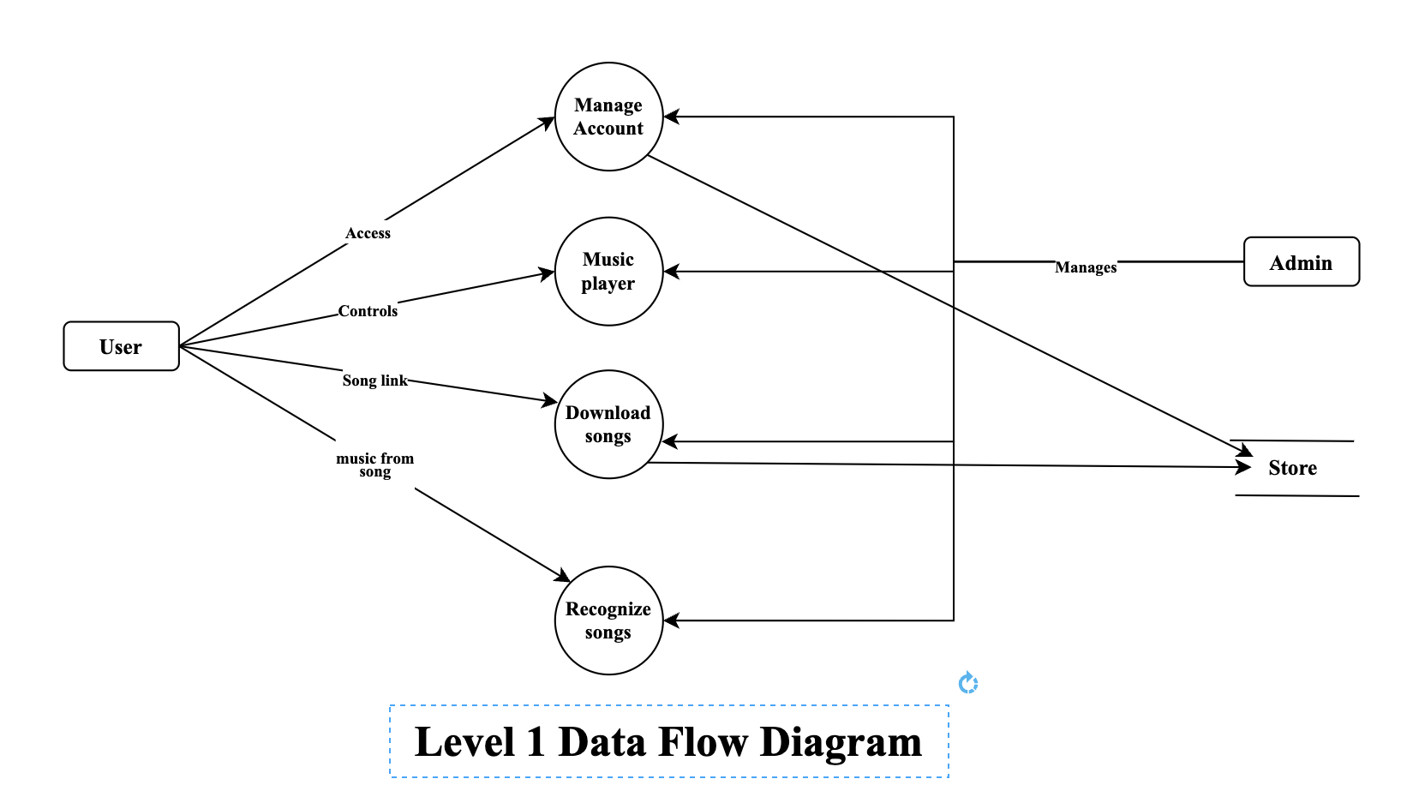
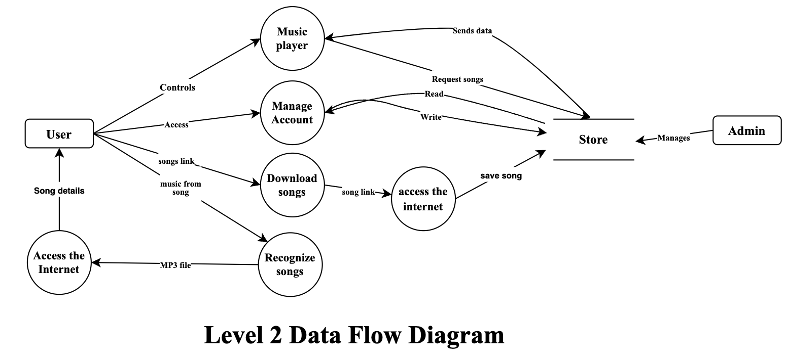
Use - case diagram :

Slide 9
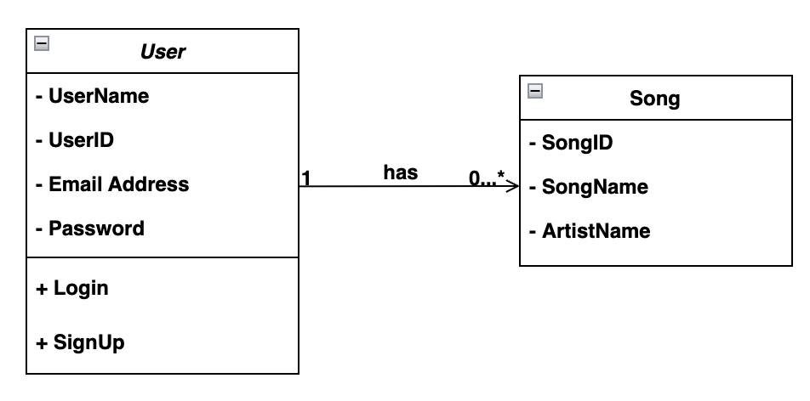
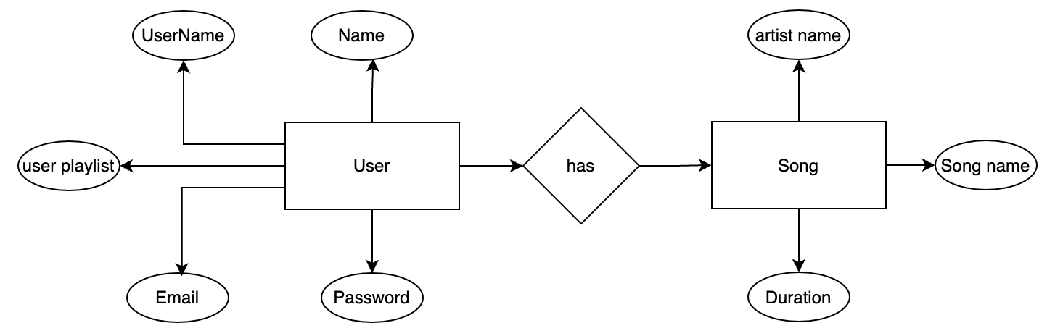
ER and Class diagram :

Slide 10
Front End Description :
In your front-end project, you're using a powerful combination of technologies to create modern and efficient web applications:
React : A JavaScript library for building dynamic and interactive user interfaces with reusable components.
Tailwind CSS : A utility-first CSS framework that provides pre-built classes for quick and consistent styling.
Vite : A modern build tool that offers fast startup times and efficient hot module replacement for a smoother development experience.
Formik : A React form library that simplifies form state management and validation.
Yup : A data validation library that works well with Formik, allowing you to define and enforce validation schemas for forms.
Together, these technologies enable you to build responsive, high-quality web applications efficiently.

Slide 11
Database Description :
Your project uses MongoDB as the database with Mongoose as the ORM for convenient database interactions. The database consists of three primary entities: User, and Song.
User:
Name (string): The user's full name.
Username (string): The user's chosen username.
Email (string): The user's email address.
Password (string): The user's password.
Song:
Name (string): The song title.
Artist Name (string): The artist or band who created the song.
Duration (string): The length of the song.

Slide 12
Database Description :
Your project uses MongoDB as the database with Mongoose as the ORM for convenient database interactions. The database consists of three primary entities: User, and Song.
User:
Name (string): The user's full name.
Username (string): The user's chosen username.
Email (string): The user's email address.
Password (string): The user's password.
Song:
Name (string): The song title.
Artist Name (string): The artist or band who created the song.
Duration (string): The length of the song.

Slide 13
Testing :

Slide 14
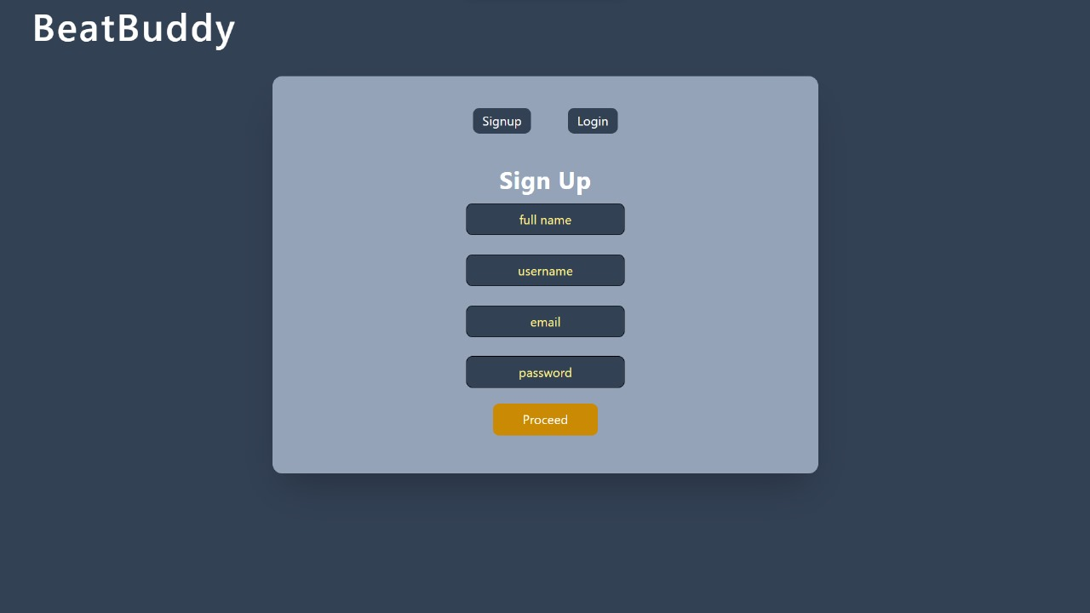
Application Images :
Login and Signup page

Slide 15
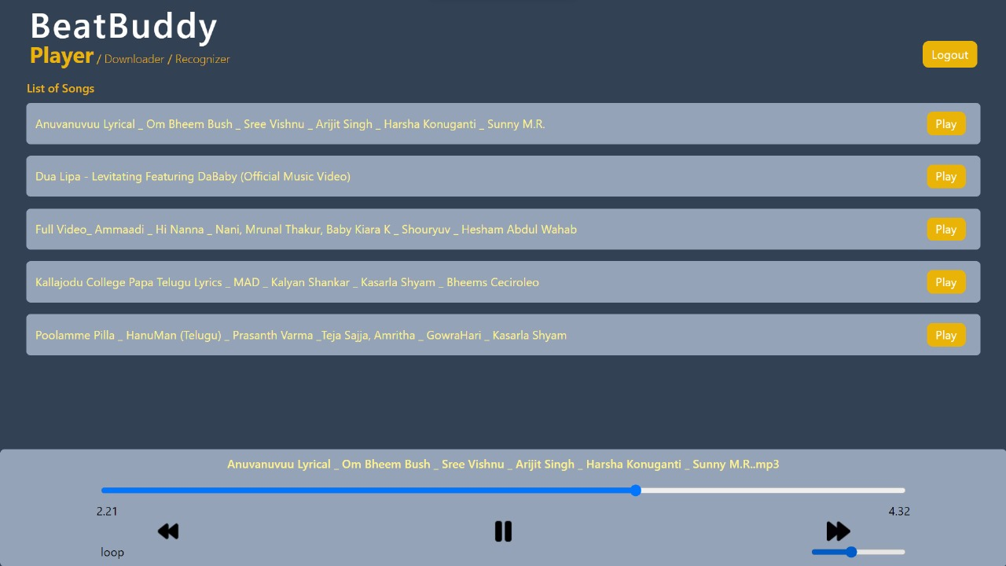
Music player page

Slide 16
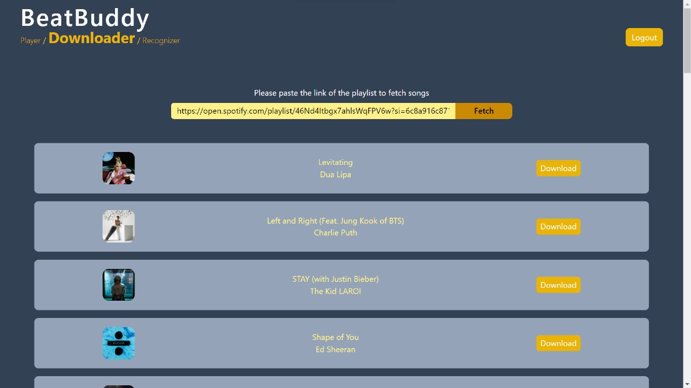
Inbuilt music downloader page

Slide 17
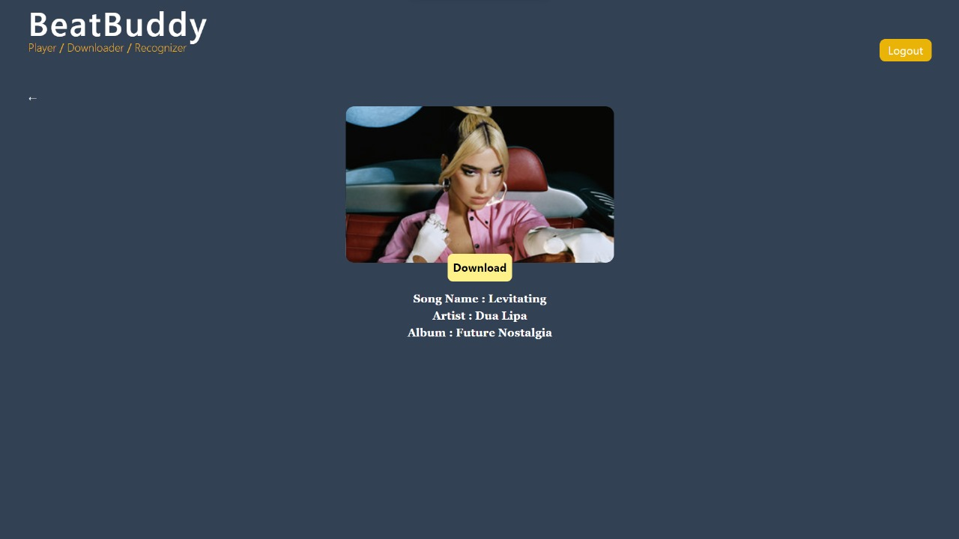
Specific song downloader page

Slide 18
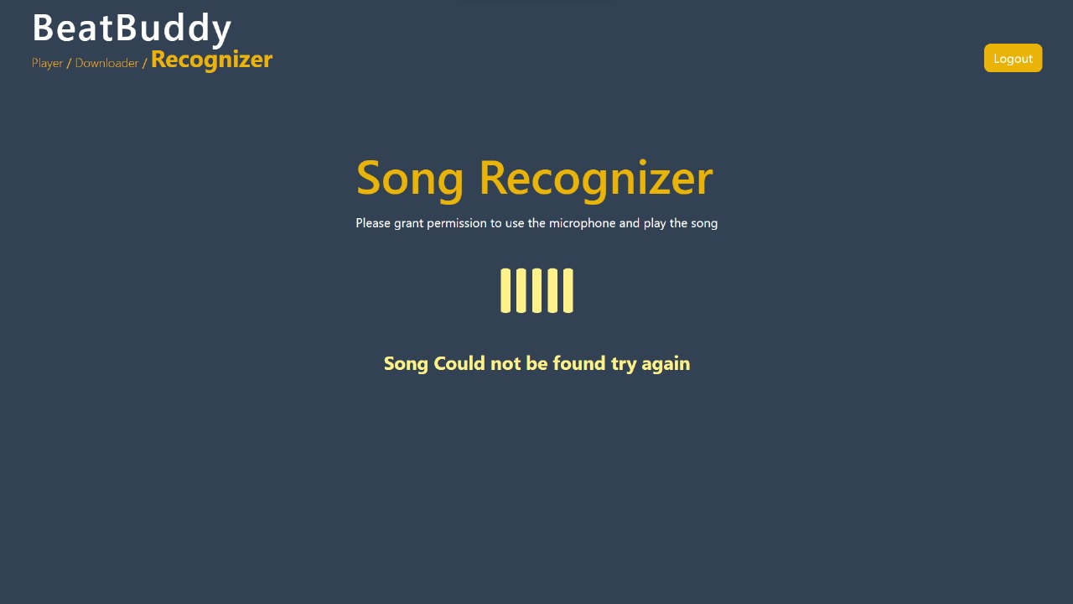
Song recognizer page

Slide 19
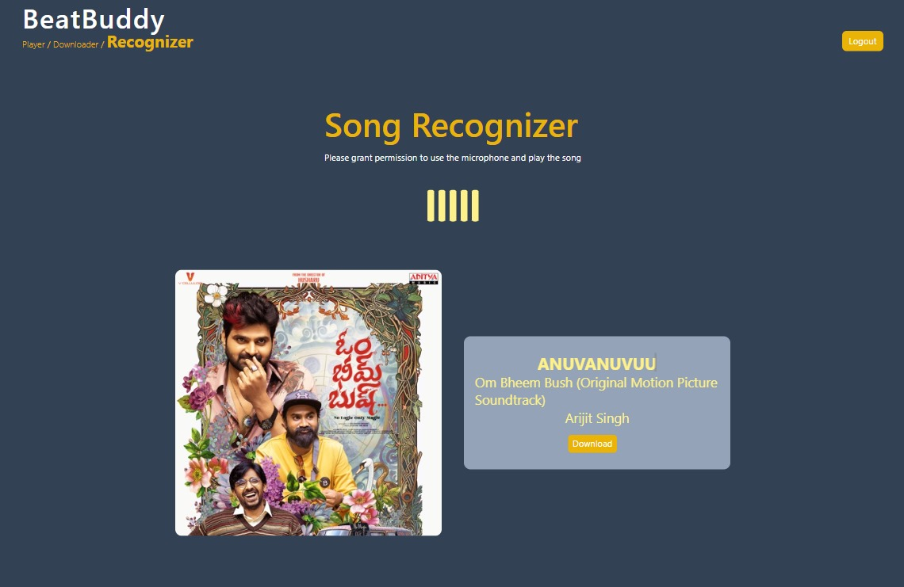
Song recognizer result page

Slide 20
Conclusion :
Beat Buddy offers a comprehensive, user-centric music management and playback platform for music enthusiasts.
Advanced audio recognition technology enables users to effortlessly identify songs and access detailed song information.
Supports various audio file formats and quality levels, allowing users to enjoy their music offline with ease.
The robust music player includes essential playback controls and a sleek interface for a tailored listening experience.
Focuses on user account management to provide a personalized experience, securely storing user preferences and settings.
Meets non-functional requirements such as performance, reliability, security, usability, and compatibility across devices and platforms.
Aims to revolutionize how users manage, discover, and enjoy their music collections with a reliable and intuitive solution.

Slide 21
References :
Vite - https://vitejs.dev/guide/
Node - https://nodejs.org/en
React Router - https://reactrouter.com/en/main
NPM - https://www.npmjs.com/
MongoDB- https://www.mongodb.com/
Rapidapi - https://rapidapi.com/hub
Tailwind - https://tailwindcss.com/

Slide 22
Thank you

